Slide 1
DC motor and PWM

Slide 2
Topics
Making Robots with Motors
DC motor
  Unidirectional control
  Bidirectional control
PWM modes
  Wave generating using Fast PWM
  Wave generating using Phase correct PWM

Slide 3

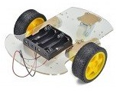

Some robots with 2 DC motors

Slide 4
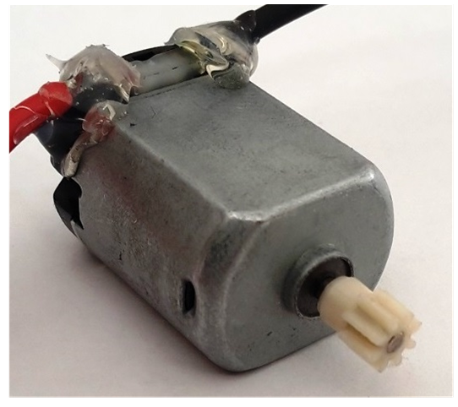

DC motor

Slide 5

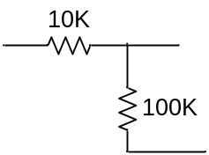
Unidirectional control
+12V
AVR
Analog Ground
M
VCC
Analog
Power
GND
TIP120
+5^{V}
Digital Ground

Slide 6
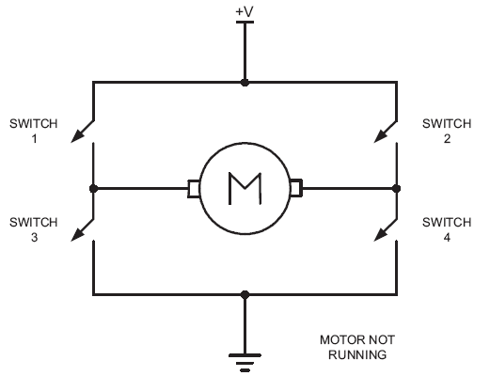
Bidirectional control

Slide 7
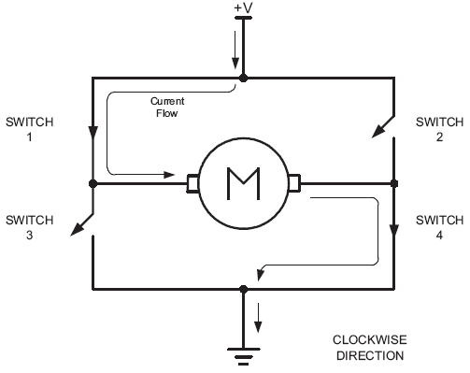
Bidirectional (clock wise)

Slide 8
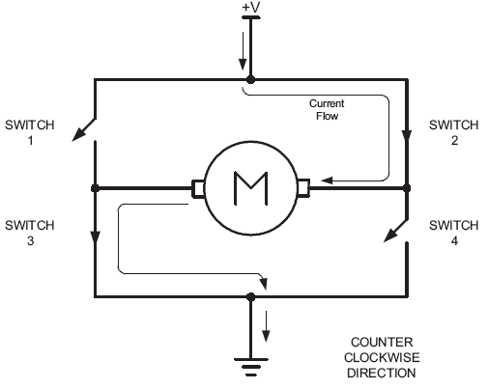
Bidirectional (counter clockwise)

Slide 9
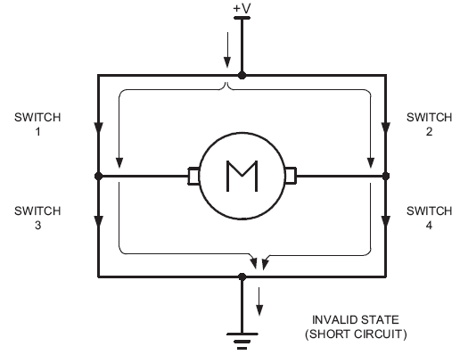
Bidirectional

Slide 10
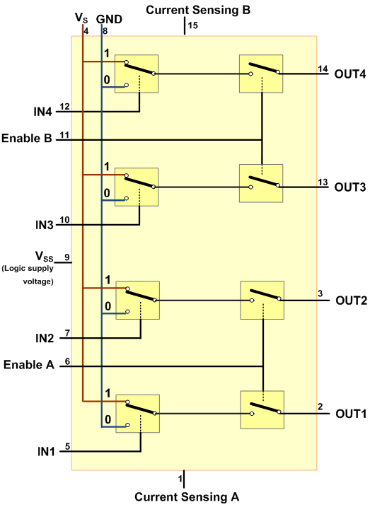
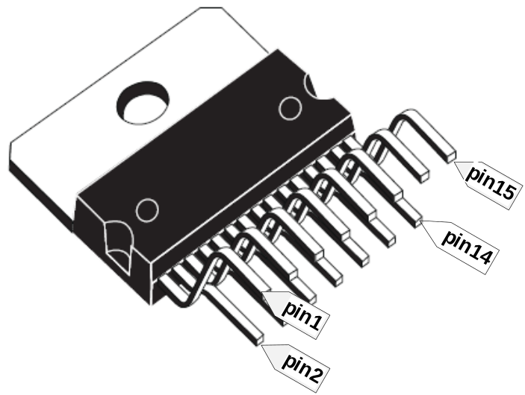
L298

Slide 11
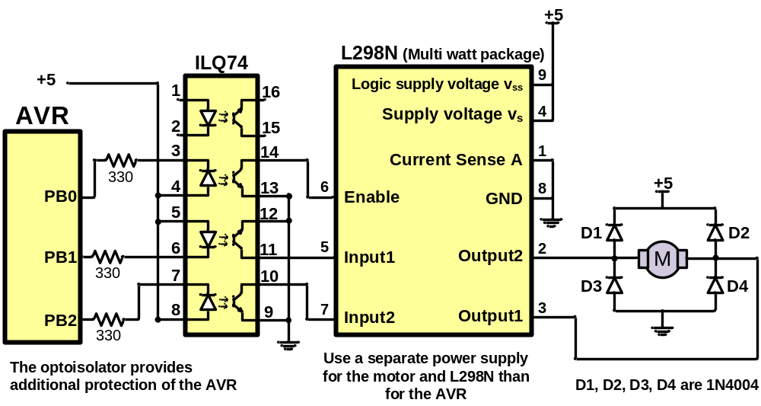
Using L298N

Slide 12
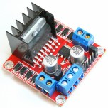
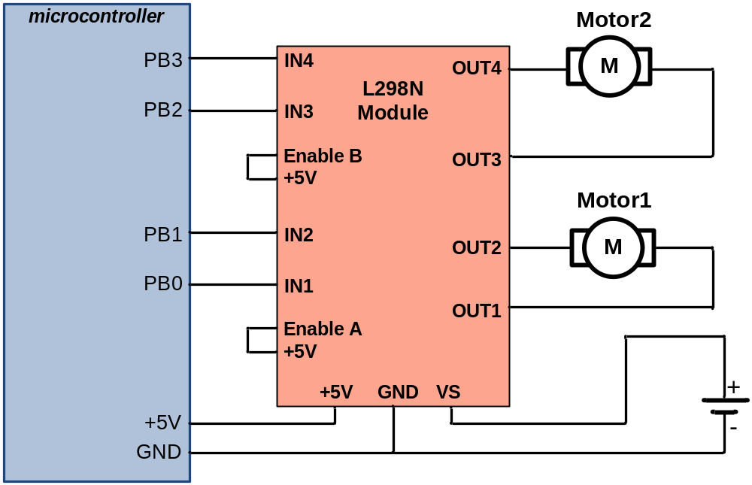
L298 module

Slide 13
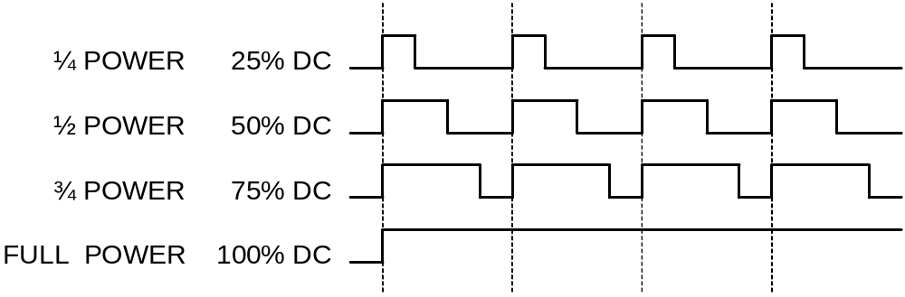
PWM and Duty Cycle

Slide 14
Timer0 Review
TCCR0A
TCCR0B
OCR0A
TCNT0
OCR0B
TOV0
=
=
OCF0A
OCF0B

Slide 15
Timer Mode (WGM)
WGM02 WGM01 WGM00 Comment
0 0 0 Normal
0 0 1 Phase correct PWM
0 1 0 CTC (Clear Timer on Compare Match)
0 1 1 Fast PWM
1 0 0 Reserved
1 0 1 Phase correct PWM
1 1 0 Reserved
1 1 1 Fast PWM

Slide 16
Fast PWM mode
Similar to Normal mode but OCR0x are buffered.
0
TCNT0
TOV0:
1
0xFF
TOV
TOV
TOV
0
time
TCNT0
FF
TOV0
=
OCF0x
FE
OCR0x
2
1
TOV0
0
TOV0 = 1
OCR0x-BUF

Slide 17
Phase Correct PWM mode
Goes up and down like a yo-yo
When TCNT becomes zero, the TOV0 flag sets.
0
TCNT0
TOV0:
1
0xFF
0
TOV
time
FF
TCNT0
FE
TOV0
=
OCF0x
2
OCR0x
TCNT0=0xFF
1
0
TOV0 = 1
OCR0x-BUF

Slide 18
Compare Output Mode (COM)
COM0x1 | COM0x0 | Description
0 | 0 | Normal port operation, OC0 disconnected
0 | 1 | Toggle OC0 on compare match
1 | 0 | Clear OC0 on compare match
1 | 1 | Set OC0 on compare match
CTC or Normal (Non PWM)
COM0x1 | COM0x0 | Description
0 | 0 | Normal port operation, OC0 disconnected
0 | 1 | Reserved
1 | 0 | Clear OC0 on compare match, set OC0 at TOP.
1 | 1 | Set OC0 on compare match, clear OC0 at TOP.
Fast PWM
COM0x1 | COM0x0 | Description
0 | 0 | Normal port operation, OC0 disconnected
0 | 1 | Reserved
1 | 0 | Clear OC0 on compare match when up-counting. Set OC0 on compare match when down-counting.
1 | 1 | Set OC0 on compare match when up-counting. Clear OC0 on compare match when down-counting.
Phase Correct PWM

Slide 19
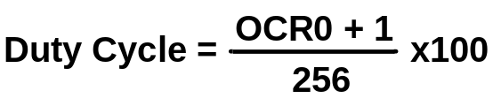
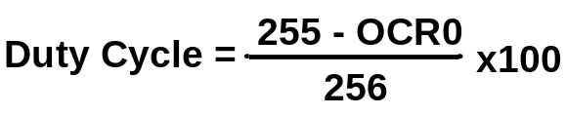
Fast PWM Calculations
Fast PWM
Duty cycle = changeable (0% to 100%)
Frequency = selectable between limited choices
TCNT0
TCNT0
0xFF
0xFF
OCR0x
OCR0x
0
0
OC0x
OC0x
COM=2
COM=2
COM=2
OC0x
OC0x
COM=3
COM=3
COM=3
f_{clk}
F_{OC0}=
N(256)

Slide 20
Assuming XTAL = 16 MHz, make the following pulse duty cycle = 75% and frequency = 62.500KHz
f_{clk}
16MHz
16MHz
F_{OC0}=
62.500KHz=
N =
=1
N(256)
N(256)
62.500K*256
75/100 = (OCR0x+1)/256 ➔ OCR0x+1 = 192 ➔ OCR0x = 191
DDRD |= (1<<6); //PD6 as output
OCR0A = 191;
TCCR0A = (1<<COM0A1)|(1<<WGM01)|(1<<WGM00);
TCCR0B = 0x01; //N = 1 (no prescaler)
SBI DDRD, 6
LDI R20,191
OUT OCR0A,R20
LDI R20, (1<<COM0A1)|(1<<WGM01)|(1<<WGM00)
OUT TCCR0A,R20
LDI R20,0x01
OUT TCCR0B,R20

Slide 21
Compare Output Mode (COM)
COM0x1 | COM0x0 | Description
0 | 0 | Normal port operation, OC0 disconnected
0 | 1 | Toggle OC0 on compare match
1 | 0 | Clear OC0 on compare match
1 | 1 | Set OC0 on compare match
CTC or Normal (Non PWM)
COM0x1 | COM0x0 | Description
0 | 0 | Normal port operation, OC0 disconnected
0 | 1 | Reserved
1 | 0 | Clear OC0 on compare match, set OC0 at TOP.
1 | 1 | Set OC0 on compare match, clear OC0 at TOP.
Fast PWM
COM0x1 | COM0x0 | Description
0 | 0 | Normal port operation, OC0 disconnected
0 | 1 | Reserved
1 | 0 | Clear OC0 on compare match when up-counting. Set OC0 on compare match when down-counting.
1 | 1 | Set OC0 on compare match when up-counting. Clear OC0 on compare match when down-counting.
Phase Correct PWM

Slide 22

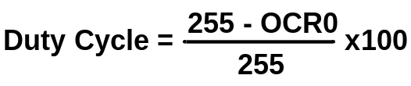
Phase Correct PWM Calculations
Phase Correct PWM
Duty cycle = changeable (0% to 100%)
Frequency = selectable between limited choices
TCNT0
TCNT0
0xFF
0xFF
OCR0x
OCR0x
0
0
OC0x
OC0x
COM=2
OC0x
OC0x
COM=3
f_{clk}
F_{OC0}=
N(510)

Slide 23
Assuming XTAL = 16 MHz, make the following wave: duty cycle = 75% and frequency = 31.372KHz
f_{clk}
16MHz
16MHz
F_{OC0}=
31.372KHz=
N =
=1
N(510)
N(510)
31.372K*510
75/100 = OCR0x / 255 ➔ OCR0x = 191
DDRD |= (1<<6); //PD6 as output
OCR0A = 191;
TCCR0A = (1<<COM0A1)|(1<<WGM00);
TCCR0B = 0x01; //N = 1 (no prescaler)

Slide 24
Unidirectional Speed Control
+12V
AVR
AVR
Analog Ground
M
VCC
VCC
Analog
Power
GND
GND
OC0A
OC0A
TIP120
+5^{V}
Digital Ground

Slide 25
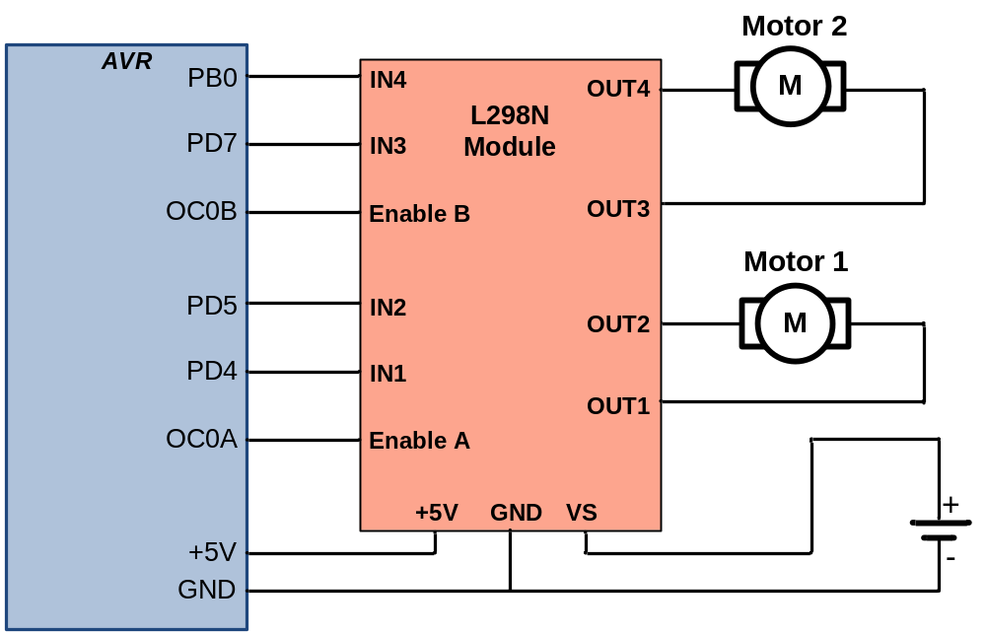
Bidirectional Speed Control

